Slide 1
CAPSTONE-Project Credit card fraud detection
PRESENTATION
Narayana Isanaka

Slide 2
Problem statement
Business problem overview
For many banks, retaining high profitable customers is the number one business goal. Banking fraud, however, poses a significant threat to this goal for different banks. In terms of substantial financial losses, trust and credibility, this is a concerning issue to both banks and customers alike.
It has been estimated by Nilson Report that by 2020, banking frauds would account for $30 billion worldwide. With the rise in digital payment channels, the number of fraudulent transactions is also increasing in new and different ways.
In the banking industry, credit card fraud detection using machine learning is not only a trend but a necessity for them to put proactive monitoring and fraud prevention mechanisms in place. Machine learning is helping these institutions to reduce time-consuming manual reviews, costly chargebacks and fees as well as denials of legitimate transactions.

Slide 3
Objective
Credit card fraud detection
banking frauds would account for $30 billion worldwide.
credit card fraud detection using machine learning Helps:
Proactive monitoring
Fraud prevention mechanisms
Machine learning reduce time-consuming manual reviews
Risks:
Detect Fraud transaction accurately.
Detect low value high frequent transaction well
Detect high value low frequent transactions well
Do not classify a non-fraud transaction as fraudulent transaction
GOAL is to develop multiple models to classify transactions as Fraud/non-fraud. Evaluate models and determine the best model.

Slide 4
Exploratory Data Analysis [EDA]
Credit card fraud detection

Slide 5
Understand the Data set
Exploratory Data Analysis
Nature of data, related data sets, domain, timeframe and size of the data set.
Metadata
Data Cleaning
Fix Rows and columns
Fix missing values
Standardise values
Fix invalid values
Filter data
Data Cleaning
Data Analysis
Recommendations
Understanding the Data set
Data Analysis
Perform Univariate Analysis
Segmented Univariate Analysis
Bivariate analysis
Derived metrics
Insights & Recommendations
Extract insights and provide recommendations

Slide 6
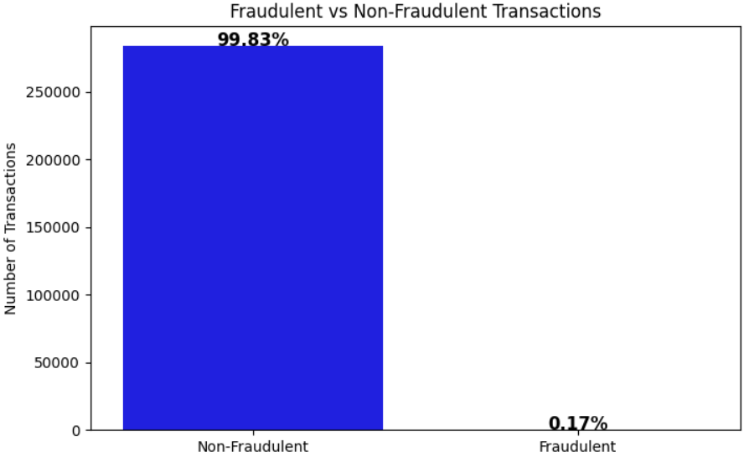
Understanding the Data set. Key findings
The dataset has PCA performed data and has tow columns Time and Amount.
The dataset has total of 284807 transactions
There are 31 fields in total of them 29 PCA derived fields , additional Time and Amount fields.
The data set has Total of 284807 transactions: - with Non-Fraudulent Transactions: 284315 (99.83%) - Fraudulent Transactions: 492 (0.17%)

Slide 7
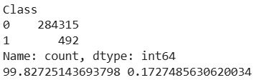
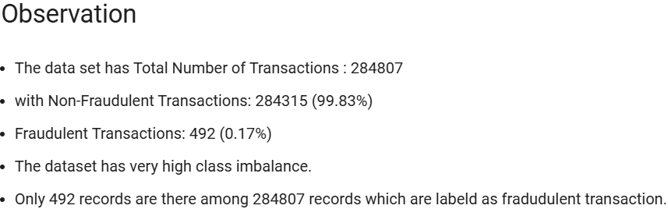
Data cleaning. Key findings
There are no null values.
Time and Amount are the only normal values
All other fields are values obtained after performing PCA on original dataset.
All the columns are of type float64 except from column Class which is int64
Class value of 1 – represents Fraud transaction
Class value of 0 – represents Non-Fraud transaction

Slide 8
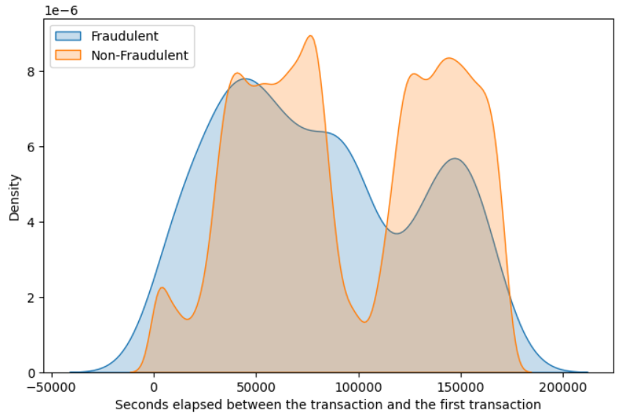
Data Analysis. Key findings
There is significant overlap between the two distributions, meaning time alone is not a perfect differentiator for fraud detection.
Feature Engineering Ideas:
Time since last transaction – Fraudulent transactions might cluster within short intervals.
Transaction burst frequency – Fraudsters may execute multiple transactions in quick succession.
Time-based anomaly detection – Outliers in transaction timing could indicate fraudulent behavior.
Time of day effects – Fraudulent transactions may peak at unusual hours.
This is a kernel density estimation (KDE) plot showing the distribution of elapsed time (in seconds) between a given transaction and the first transaction, for both fraudulent and non-fraudulent transactions.

Slide 9
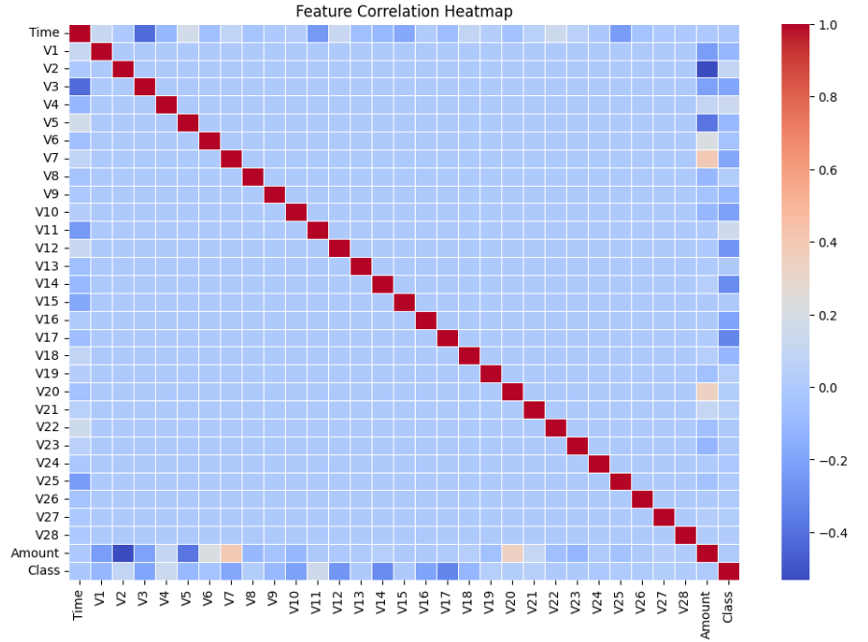
Insights & Recommendations. Key findings

Slide 10
Model building

Slide 11
Model: Key findings
Model: Key findings
There are no null values.

Slide 12

Overcoming
Nervousness

Slide 13
NAVIGATING Q&A SESSIONS
Know your material in advance
Anticipate common questions
Rehearse your responses
Maintaining composure during the Q&A session is essential for projecting confidence and authority. Consider the following tips for staying composed:
Stay calm
Actively listen
Pause and reflect
Maintain eye contact

Slide 14
SPEAKING ENGAGEMENT METRICS
IMPACT FACTOR | MEASUREMENT | TARGET | ACHIEVED
Audience interaction | Percentage (%) | 85 | 88
Knowledge retention | Percentage (%) | 75 | 80
Post-presentation surveys | Average rating | 4.2 | 4.5
Referral rate | Percentage (%) | 10 | 12
Collaboration opportunities | # of opportunities | 8 | 10

Slide 15
The Power of
Communication

Slide 16
Overcoming
Nervousness

Slide 17
ENGAGING THE AUDIENCE
Make eye contact with your audience to create a sense of intimacy and involvement
Weave relatable stories into your presentation using narratives that make your message memorable and impactful
Encourage questions and provide thoughtful responses to enhance audience participation
Use live polls or surveys to gather audience opinions, promoting engagement and making sure the audience feel involved

Slide 18
SELECTING VISUAL AIDS
ENHANCING YOUR PRESENTATION

Slide 19
EFFECTIVE DELIVERY TECHNIQUES
This is a powerful tool in public speaking. It involves varying pitch, tone, and volume to convey emotion, emphasize points, and maintain interest.
Pitch variation
Tone inflection
Volume control
Effective body language enhances your message, making it more impactful and memorable.
Meaningful eye contact
Purposeful gestures
Maintain good posture
Control your expressions

Slide 20
NAVIGATING Q&A SESSIONS
Know your material in advance
Anticipate common questions
Rehearse your responses
Maintaining composure during the Q&A session is essential for projecting confidence and authority. Consider the following tips for staying composed:
Stay calm
Actively listen
Pause and reflect
Maintain eye contact

Slide 21

SPEAKING IMPACT
Your ability to communicate effectively will leave a lasting impact on your audience
Effectively communicating involves not only delivering a message but also resonating with the experiences, values, and emotions of those listening

Slide 22
DYNAMIC DELIVERY
METRIC | MEASUREMENT | TARGET | ACTUAL
Audience attendance | # of attendees | 150 | 120
Engagement duration | Minutes | 60 | 75
Q&A interaction | # of questions | 10 | 15
Positive feedback | Percentage (%) | 90 | 95
Rate of information retention | Percentage (%) | 80 | 85
Learn to infuse energy into your delivery to leave a lasting impression
One of the goals of effective communication is to motivate your audience

Slide 23
Data Insights & Recommendations
Consistent rehearsal
Strengthen your familiarity
Refine delivery style
Pacing, tone, and emphasis
Timing and transitions
Aim for seamless, professional delivery
Practice audience
Enlist colleagues to listen & provide feedback
Seek feedback
Reflect on performance
Explore new techniques
Set personal goals
Iterate and adapt

Slide 24
Data Insights & Recommendations
Consistent rehearsal
Strengthen your familiarity
Refine delivery style
Pacing, tone, and emphasis
Timing and transitions
Aim for seamless, professional delivery
Practice audience
Enlist colleagues to listen & provide feedback
Seek feedback
Reflect on performance
Explore new techniques
Set personal goals
Iterate and adapt

Slide 25
Data Insights & Recommendations
Consistent rehearsal
Strengthen your familiarity
Refine delivery style
Pacing, tone, and emphasis
Timing and transitions
Aim for seamless, professional delivery
Practice audience
Enlist colleagues to listen & provide feedback
Seek feedback
Reflect on performance
Explore new techniques
Set personal goals
Iterate and adapt

Slide 26
THANK YOU!!
Narayana Isanaka

